Slide 1

Twitters analysis relate to Covid-19 infection
Presenter: Dongni Yang

Slide 2




Executive Summary
Project Goals
Data cleaning & extending
This project is going to identify whether Twitter can be considered a credible source of information, which reflects the risk of contracting a COVID infection.
Data Analysis
≈
Author Identification
Location analysis
Timeline analysis
Messages unique
analysis
Conclusions & Recommendation
≈
We conclude that Twitter can reflect the severity of the covid-19 pandemic.

Slide 3
EDA & Tweet clean-up and filtering
EDA
From Twitter Data Dictionary, we can roughly know the useful variables we need is stored in the column ‘id’, ‘text’, ‘created at’, ‘retweeted status', 'user’ , and ‘place’.
Original Data
Covid Dictionary:
Covid/ Social Distance/ Fomite/ Pandemic/ Outbreak/ Quarantine/ etc. ^{[1]}
15448267 rows tweets
Extracted from Google Cloud Storage
Changed all the text into lower-case, go through ETA to filter the tweets only relate on Covid.
After dropping the tweets which have too many empty columns, we finally get millions of tweets related to the covid topic.
[1]: Covid dictionary: https://www.merriam-webster.com/words-at-play/coronavirus-words-guide/covid-19

Slide 4
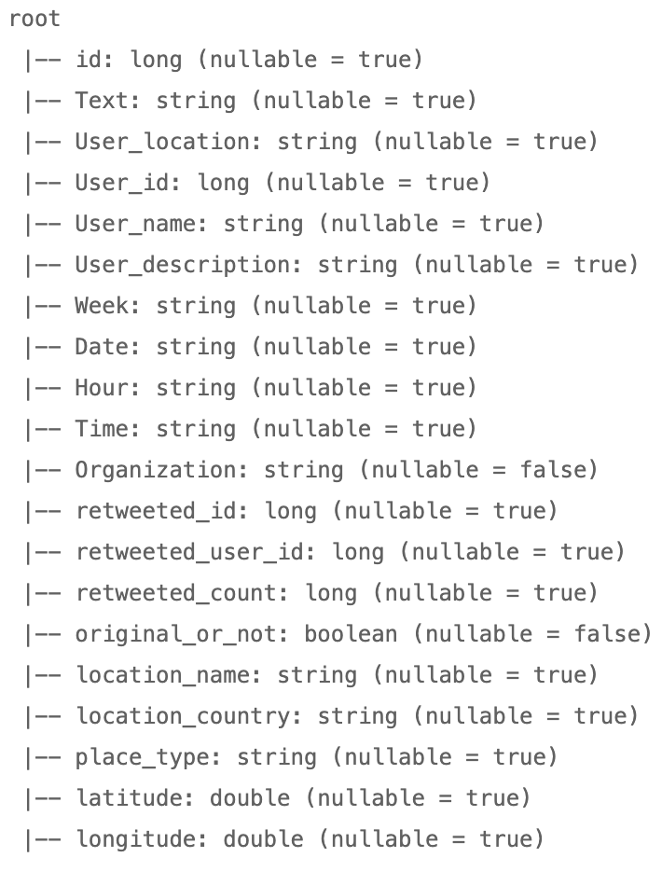
Methodology and Extensive usage of available variables
What we need and how to get it
Original Or Not:
To detect the tweet is the original tweet or not, we can column ‘Retweeted status’ from the item in the tweets column ‘user’. If ‘Retweeted status’ is null then this tweet is original, either is not.
Organization:
In order to classify Twitter’s organization, we can get the column ‘verified’ and ‘description’ from the item in the tweet's column ‘user’. By the user description, we can classify them to either one of the organizations.
Location:
We can get ‘location’ from the item in the tweet's column ‘user’. Also, in other to provide a scatter plot, we also can get ’latitude’ and ‘longitude’ from the item in the tweet’s column ‘coordinates’.
Date:
We can get ’Date’ from the item in the tweet’s column ‘Created at’ by the function substring.

Slide 5
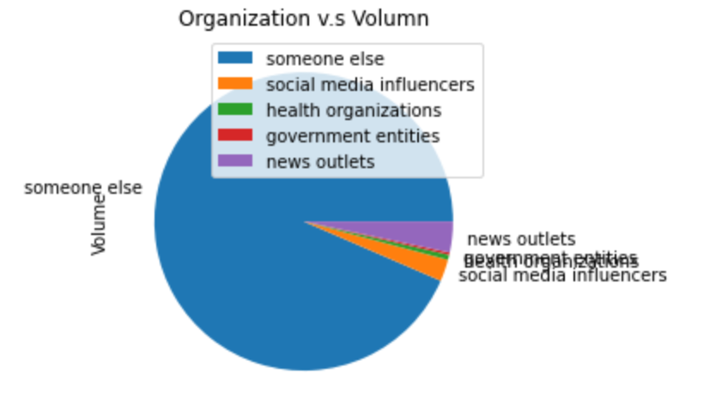
Author identification (Original tweets)
For Original tweets, after we group by the User ID, we can easily find the top five Twitters with the highest original tweets volume, none of them belong to any organization. After we group the original tweets by the organization, we can find that in the classification someone else tweeted most of the original tweets.
User ID | Volume | User Name | Organization
3219670842 | 15349 | Nathan Joyner | someone else
728894570 | 4742 | iWeller.com | someone else
1283765688616628233 | 4681 | Galla Go | someone else
1269612893529444354 | 4510 | News Bht | someone else
1015456945447170048 | 4333 | hiremaid.com.sg | someone else

Slide 6
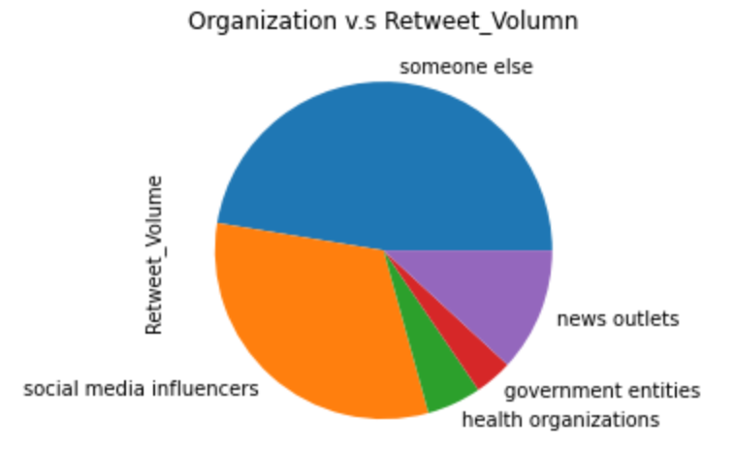
Author identification (Retweets)
For Retweets, after we group by the User ID, we find that the top five Twitters with the highest retweeted volume belong to some of the organizations. Like Biden and Modi are the presidents of the USA and India. After we group the original tweets by the organization, we can see the first is someone else and the second is media influencers.
User ID | Retweeted Volume | User Name | Organization
707231479047315456 | 431198 | PeterSweden | social media influenc.
18831926 | 418509 | Eric Feigl-Ding | health organizations
39844876 | 400338 | Robert W Malone, MD | someone else
1349149096909668363 | 378544 | President Biden | government entities
18839785 | 248354 | Narendra Modi | government entities

Slide 7
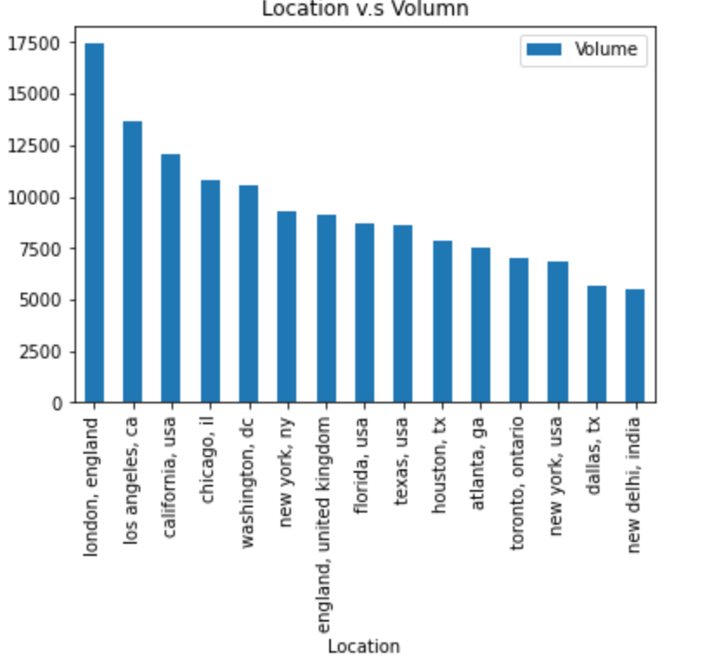
Location analysis
After we group by the location of Twitter. From the top fifteen cities of these twitters lived in. We can see most of them are from the cities of the United States, England, and India. Which also matches the result of the scatter plot in the next slide.
These three regions also are hardest hit by the Covid-19 pandemic.

Slide 8
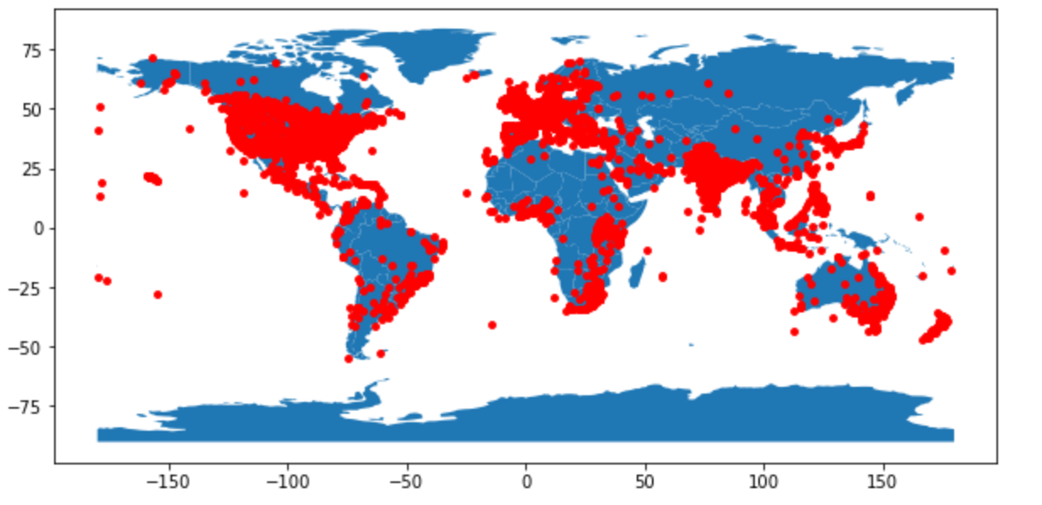
Location analysis
Scatter Plot for Twitters’ Location over world
India
United States
Europe

Slide 9
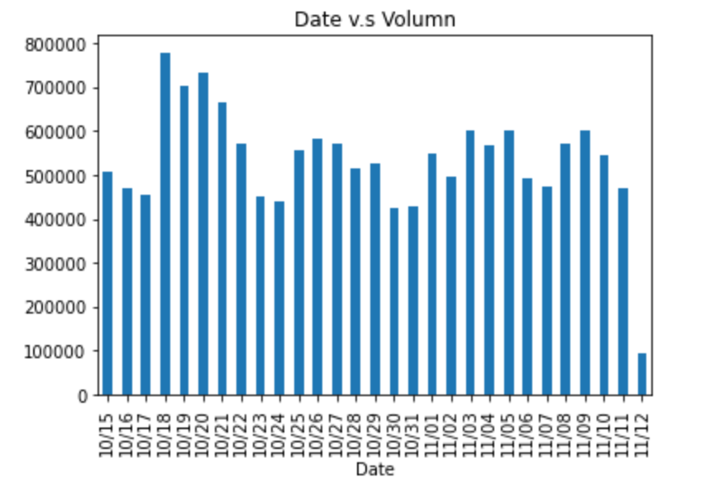
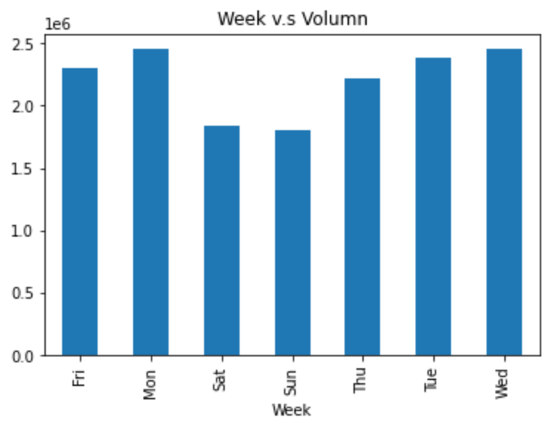
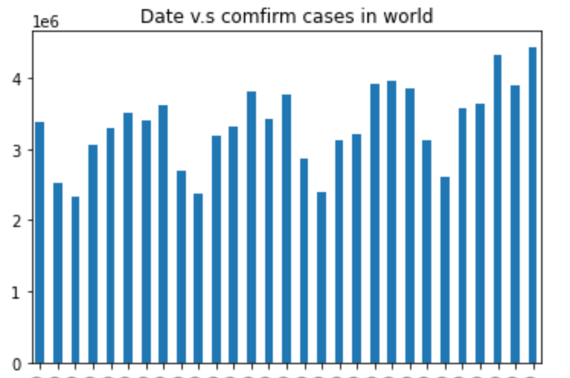
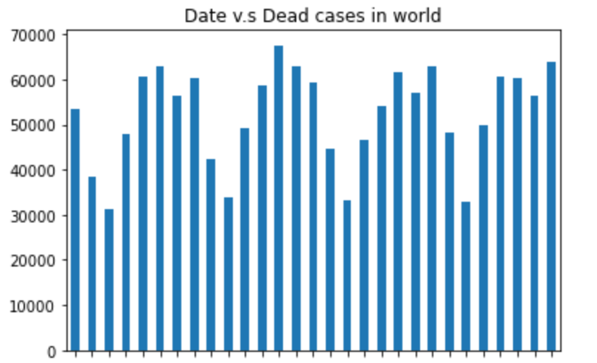
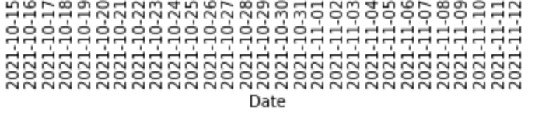
Timelines analysis
We can clearly see that there excited significant peaks and valleys, the valleys of volume is the date 10/16, 10/17,10/23, 10/24, 10/30, 10/31, 11/06, 11/07 and peaks of volume is 10/20, 10/27, 11/3, 11/10. Which also match the peaks and valleys results from the plot of daily confirm cases and the plot of daily dead cases.

Slide 10
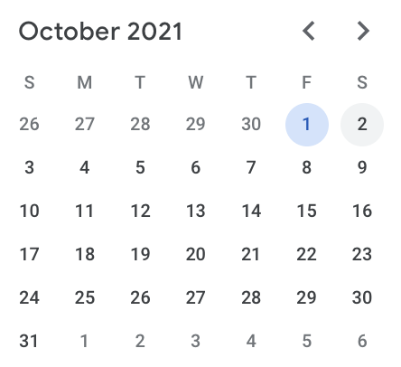
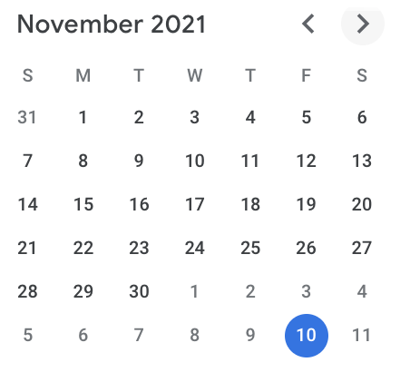
Timeline analysis
From the calendar, we can see that the valleys of the volume are every weekend of the month.

Slide 11
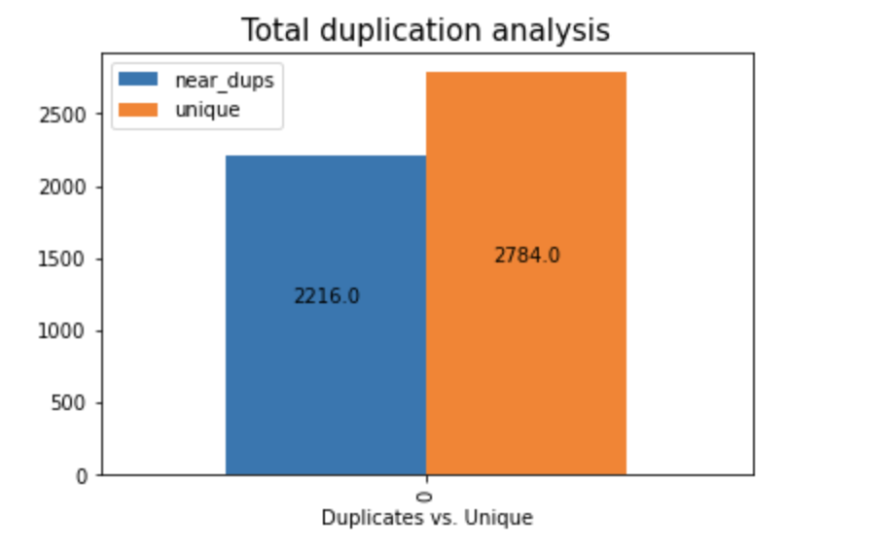
Messages unique analysis
By the LSH method (Minhash to measure uniqueness), after setting the Jaccard distance to 0.7. We can see most of the tweets are unique.

Slide 12
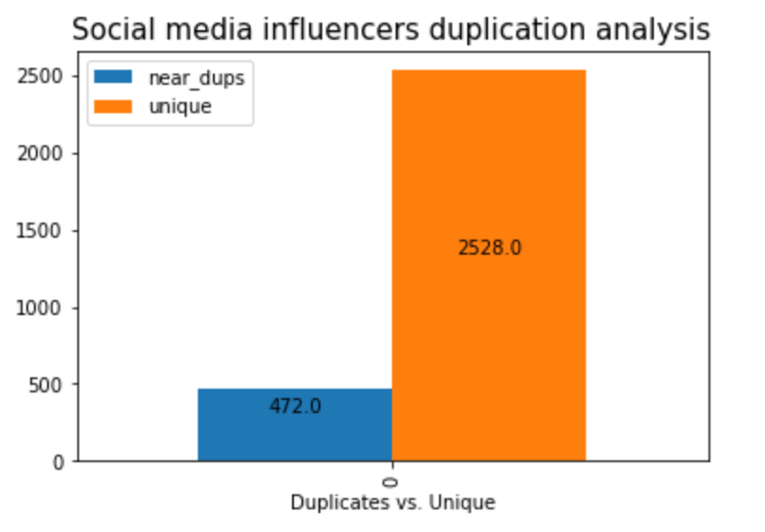
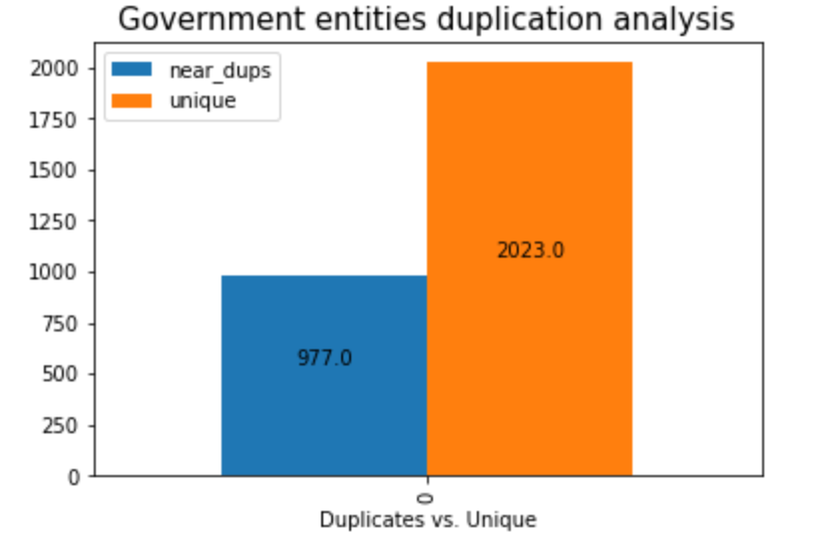
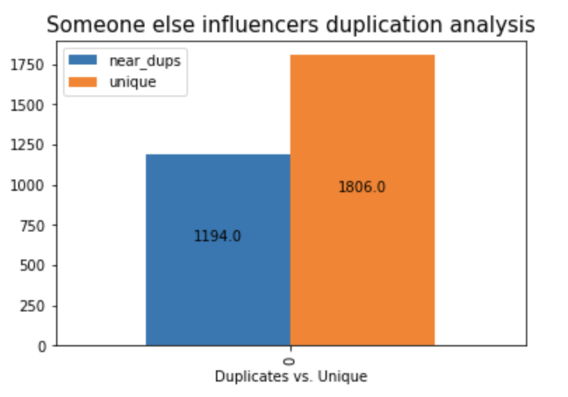
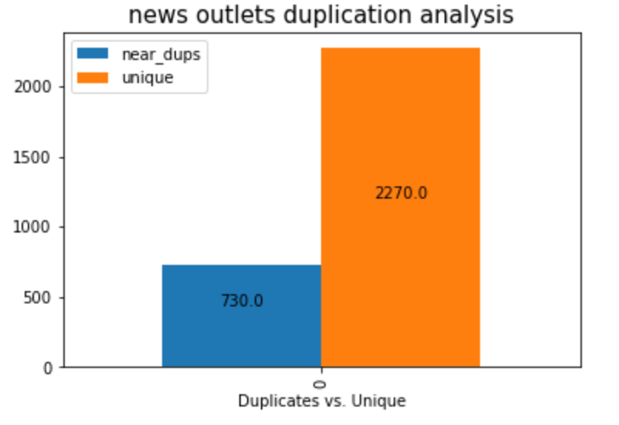
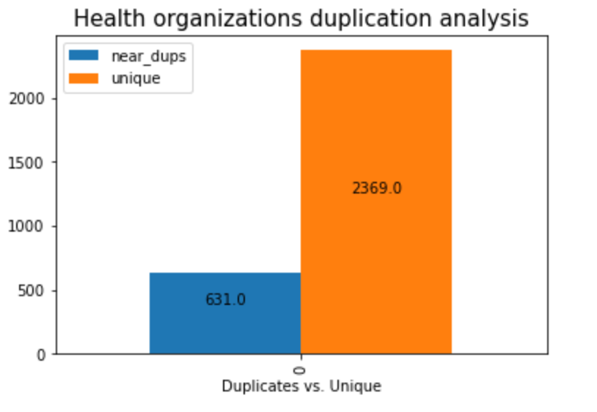
Messages unique analysis
After we classify Twitter to each organization, we see that the group Social media influencers has the lowest duplicates rate and the group Someone else has the highest duplicates rate.

Slide 13
Conclusions and Actionable recommendations
Conclusions
Actionable Recommendations
From the previous slides, we can conclude that Twitter can be considered a credible source of information, which reflects the risk of contracting a COVID infection.
There exist spikes in Twitter activity and collections in the geographical distribution of Twitterers.
Higher Tweet volumes were somehow reflective of the increased COVID risks.
The Twitterers who have the highest tweet volume tweeting about COVID are random users.
However, Twitterers who belong to one of the organizations can get more retweet volume.
Most messages are being original content.
Since we concluded that Twitter could respond to the covid infection process. Therefore, for some areas with low medical standards, if we detected an abnormal increase in tweeting volume relate to the Covid topic, we can consider providing more detecting systems and medical assistance to them.
When analyzing the data, we found that some accounts are similar to bots which have an extremely high tweets volume and few retweets. It affects our judgments about timeline and location. We can consider removing these accounts when analyzing.

Slide 14
Thank you

